Slide 1
Bible reading
Luke chapter 24:1-12; 36-49

Slide 2
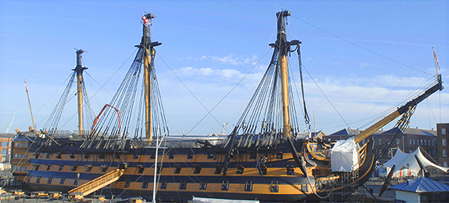
HMS Victory

Slide 3
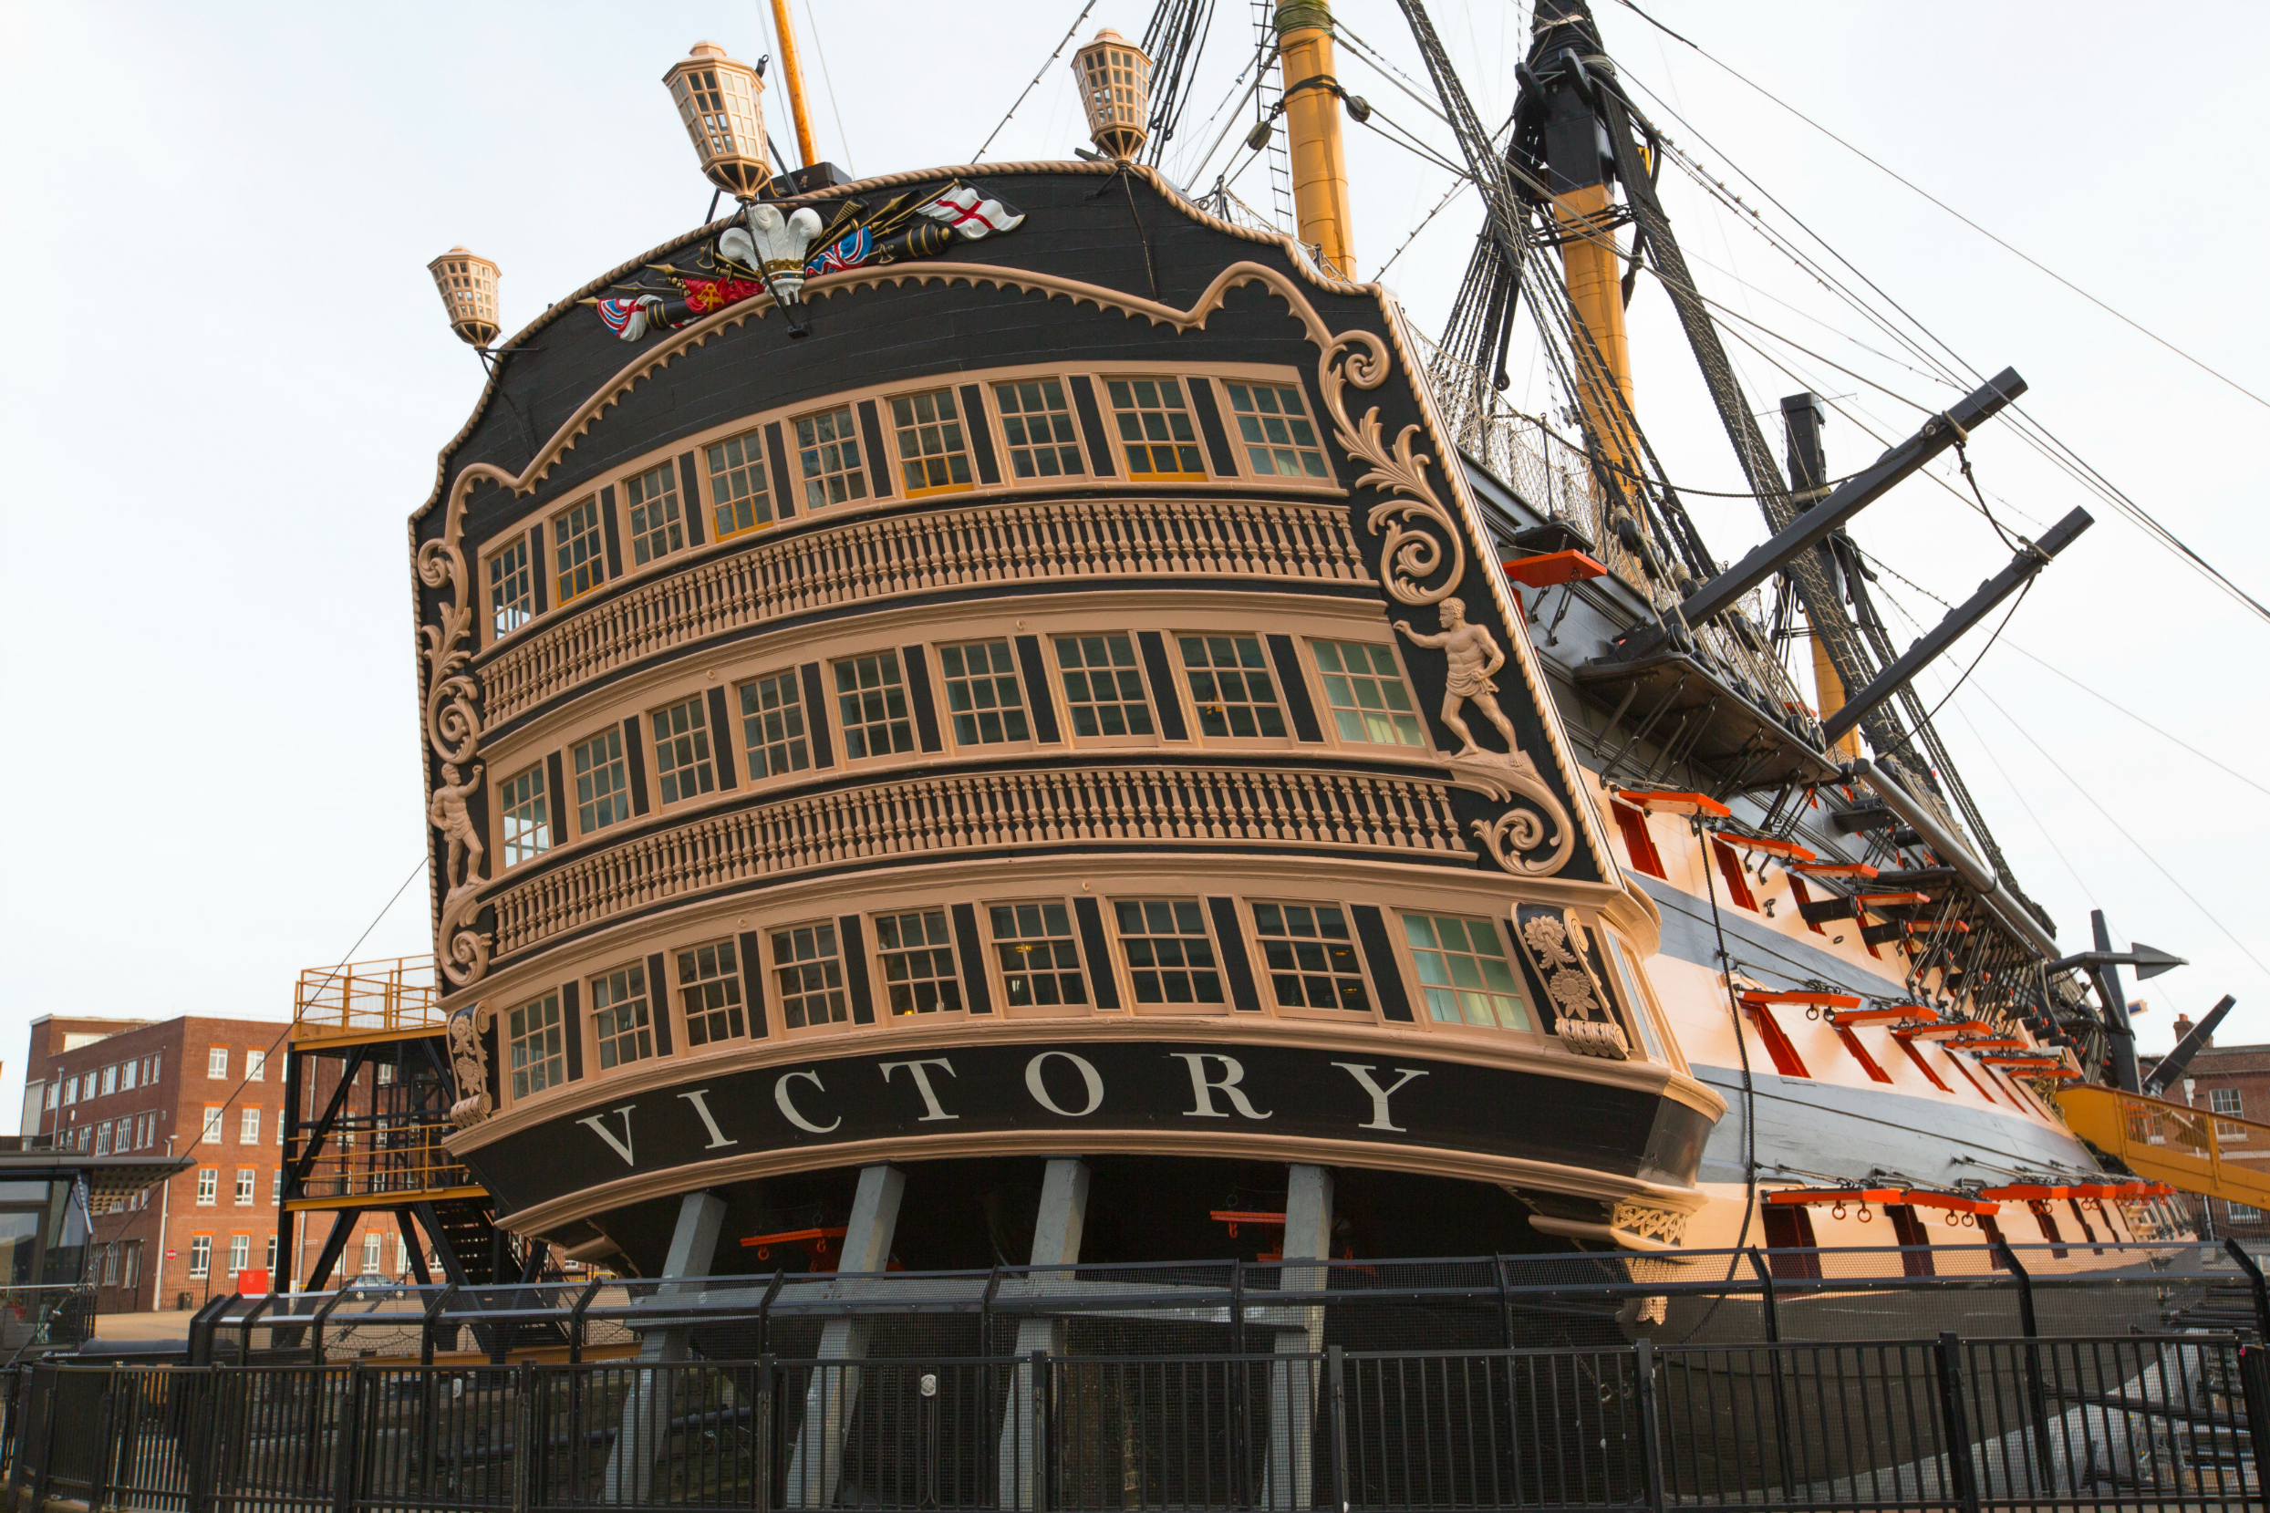

Slide 4
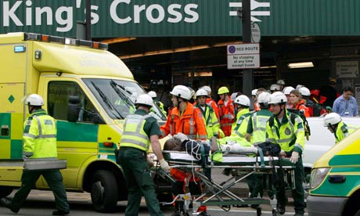

Slide 5
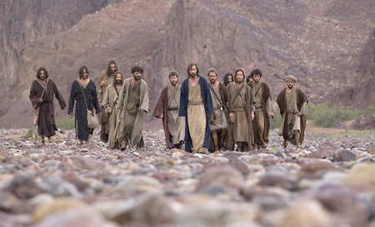

Slide 6


Slide 7
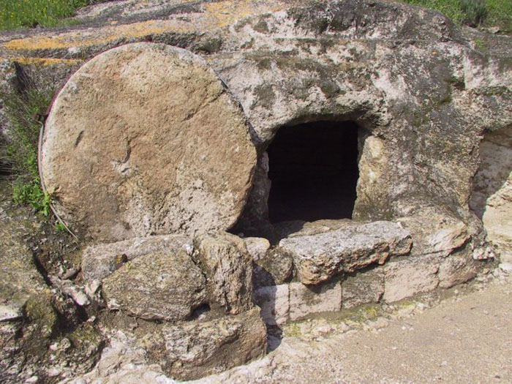

Slide 8


Slide 9
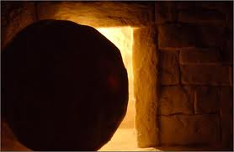
3 days later............

Slide 10
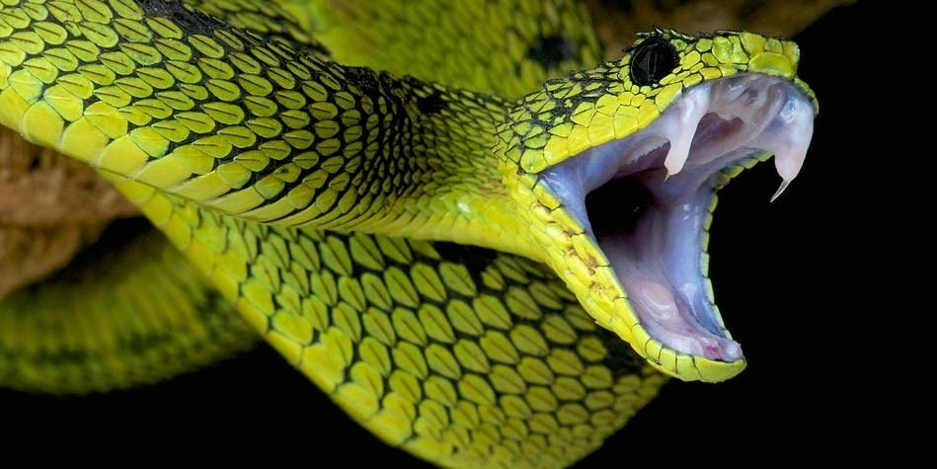

Slide 11
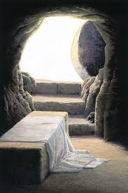
‘

Slide 13
X

Slide 14
X

Slide 15
X

Slide 16
X

Slide 18
