Slide 1
Acts 1:1-11
People, Power and the Gospel

Slide 2
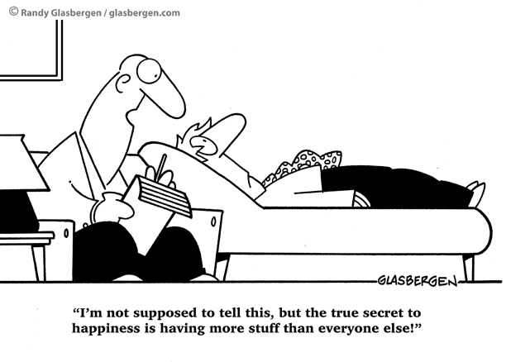

Slide 3
Acts 1:1-11
Living with EXPECTATION

Slide 4
Acts 1:1-11
1. Every local assembly/gathering needs people who know they are ‘chosen’ as the disciple were by Jesus (v1-2)

Slide 5
Acts 1:1-11
2. We need to be people who know and believe and act on the fact that Jesus is Risen from the dead (v3)

Slide 6
Acts 1:1-11
3. We need to be people who know we are joined into the spiritual body of Christ by the baptism of the Spirit – Jesus baptises us into his body with his Spirit (v4-5)

Slide 7
Acts 1:1-11
4. We need to to understand God's agenda – what it isn’t and what it is! (v6-7)

Slide 8
Acts 1:1-11
5. The Church needs people who are witnessing (v8)

Slide 9
Acts 1:1-11
6. The Church needs to be motivated by Jesus’ return (v9-11)

Slide 10
Acts 1:1-11
IM/AP-LICATION
Luke 24:44-49, Acts 1:14

